Slide 1
Chapter 9 Uniprocessor Scheduling
Operating Systems: Internals and Design Principles
Seventh Edition By William Stallings
Notes:
“Operating Systems: Internal and Design Principles”, 7/e, by William Stallings, Chapter 9 “Uniprocessor Scheduling”.

Slide 2
Operating Systems: Internals and Design Principles
“I take a two hour nap, from one o’clock to four.”
— Yogi Berra
Notes:
This chapter begins with an examination of the three types of processor scheduling,
showing how they are related. We see that long-term scheduling and mediumterm
scheduling are driven primarily by performance concerns related to the degree
of multiprogramming. These issues are dealt with to some extent in Chapter 3 and
in more detail in Chapters 7 and 8 . Thus, the remainder of this chapter concentrates
on short-term scheduling and is limited to a consideration of scheduling on a uniprocessor
system. Because the use of multiple processors adds additional complexity,
it is best to focus on the uniprocessor case first, so that the differences among
scheduling algorithms can be clearly seen.
Section 9.2 looks at the various algorithms that may be used to make short term
scheduling decisions.

Slide 3
Processor Scheduling
Aim is to assign processes to be executed by the processor in a way that meets system objectives, such as response time, throughput, and processor efficiency
Broken down into three separate functions:
long term scheduling
medium term scheduling
short term scheduling
Notes:
The aim of processor scheduling is to assign processes to be executed by the processor
or processors over time, in a way that meets system objectives, such as response
time, throughput, and processor efficiency. In many systems, this scheduling activity
is broken down into three separate functions: long-, medium-, and short-term
scheduling. The names suggest the relative time scales with which these functions are
performed.

Slide 4
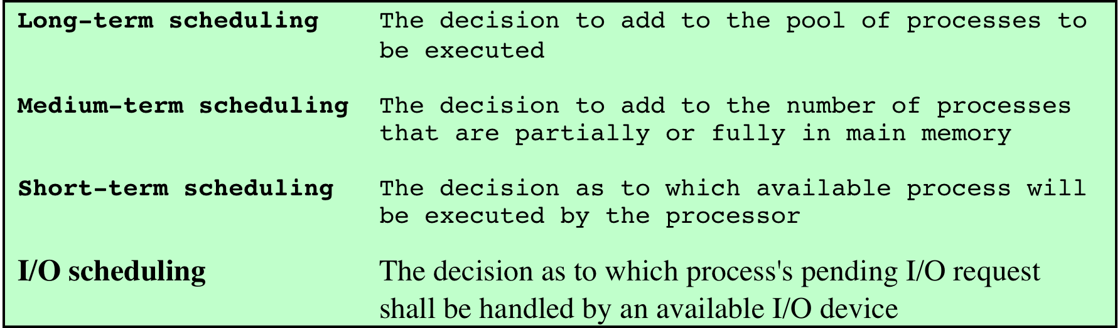
Table 9.1 Types of Scheduling
Notes:
The key to multiprogramming is scheduling. In fact, four types of scheduling
are typically involved ( Table 9.1 ). One of these, I/O scheduling, is more conveniently
addressed in Chapter 11 , where I/O is discussed. The remaining three types of scheduling,
which are types of processor scheduling, are addressed in this chapter and the next.

Slide 5
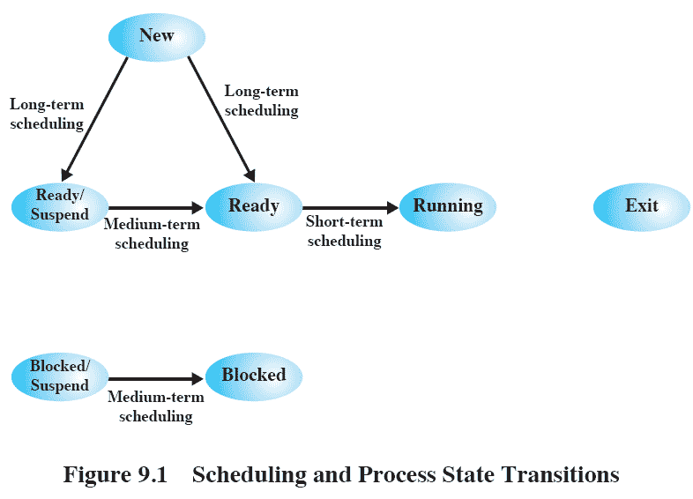
Scheduling and Process State Transitions
Notes:
Figure 9.1 relates the scheduling functions to the process state transition
diagram (first shown in Figure 3.9b ). Long-term scheduling is performed when a
new process is created. This is a decision whether to add a new process to the set
of processes that are currently active. Medium-term scheduling is a part of the
swapping function. This is a decision whether to add a process to those that are at
least partially in main memory and therefore available for execution. Short-term
scheduling is the actual decision of which ready process to execute next.

Slide 6
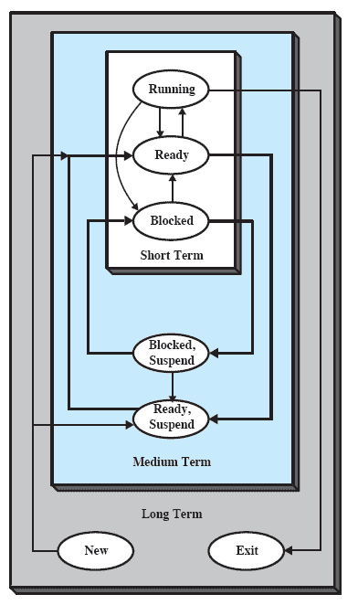
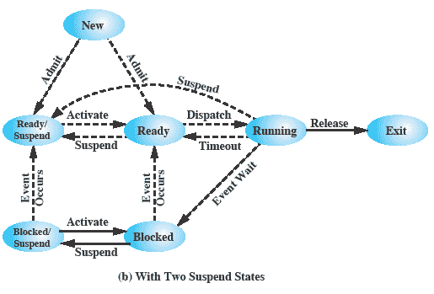
Figure 9.2 Nesting of Scheduling Functions
(Referencing figure 3.9b)
Notes:
Figure 9.2
reorganizes the state transition diagram of Figure 3.9b to suggest the nesting of
scheduling functions.

Slide 7
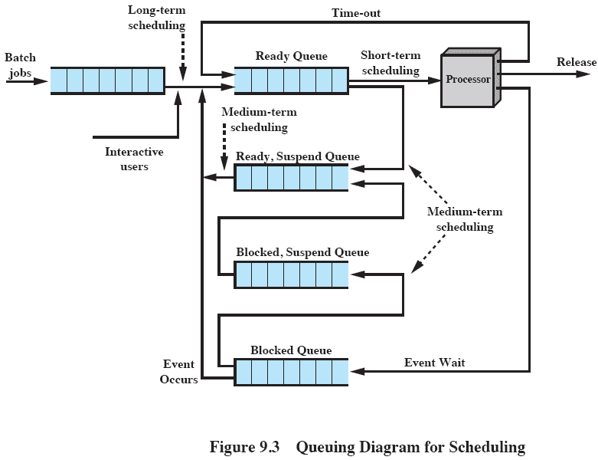
Queuing Diagram
Notes:
Scheduling affects the performance of the system because it determines
which processes will wait and which will progress. This point of view is presented in
Figure 9.3 , which shows the queues involved in the state transitions of a process. 1
Fundamentally, scheduling is a matter of managing queues to minimize queuing
delay and to optimize performance in a queuing environment.

Slide 8
Long-Term Scheduler
Determines which programs are admitted to the system for processing
Controls the degree of multiprogramming
the more processes that are created, the smaller the percentage of time that each process can be executed
may limit to provide satisfactory service to the current set of processes
Creates processes from the queue when it can, but must decide:
when the operating system can take on one or more additional processes
which jobs to accept and turn into processes
first come, first served
priority, expected execution time, I/O requirements
Notes:
The long-term scheduler determines which programs are admitted to the system for
processing. Thus, it controls the degree of multiprogramming. Once admitted, a job
or user program becomes a process and is added to the queue for the short-term
scheduler. In some systems, a newly created process begins in a swapped-out condition,
in which case it is added to a queue for the medium-term scheduler.
In a batch system, or for the batch portion of a general-purpose operating
system, newly submitted jobs are routed to disk and held in a batch queue. The long-term
scheduler creates processes from the queue when it can. There are two decisions
involved here. First, the scheduler must decide when the operating system can take
on one or more additional processes. Second, the scheduler must decide which job
or jobs to accept and turn into processes.
The decision as to when to create a new process is generally driven by the
desired degree of multiprogramming. The more processes that are created, the
smaller is the percentage of time that each process can be executed (i.e., more processes
are competing for the same amount of processor time). Thus, the long-term
scheduler may limit the degree of multiprogramming to provide satisfactory service
to the current set of processes. Each time a job terminates, the scheduler may decide
to add one or more new jobs. Additionally, if the fraction of time that the processor
is idle exceeds a certain threshold, the long-term scheduler may be invoked.
The decision as to which job to admit next can be on a simple first-comefirst-
served (FCFS) basis, or it can be a tool to manage system performance. The
criteria used may include priority, expected execution time, and I/O requirements.
For example, if the information is available, the scheduler may attempt to keep a
mix of processor-bound and I/O-bound processes. 2 Also, the decision can depend
on which I/O resources are to be requested, in an attempt to balance I/O usage.
For interactive programs in a time-sharing system, a process creation request
can be generated by the act of a user attempting to connect to the system. Timesharing
users are not simply queued up and kept waiting until the system can accept
them. Rather, the operating system will accept all authorized comers until the
system is saturated, using some predefined measure of saturation. At that point, a
connection request is met with a message indicating that the system is full and the
user should try again later.

Slide 9
Medium-Term Scheduling
Part of the swapping function
Swapping-in decisions are based on the need to manage the degree of multiprogramming
considers the memory requirements of the swapped-out processes
Notes:
Medium-term scheduling is part of the swapping function. The issues involved are
discussed in Chapters 3 , 7 , and 8 . Typically, the swapping-in decision is based on
the need to manage the degree of multiprogramming. On a system that does not
use virtual memory, memory management is also an issue. Thus, the swapping-in
decision will consider the memory requirements of the swapped-out processes.

Slide 10
Short-Term Scheduling
Known as the dispatcher
Executes most frequently
Makes the fine-grained decision of which process to execute next
Invoked when an event occurs that may lead to the blocking of the current process or that may provide an opportunity to preempt a currently running process in favor of another
Examples:
Clock interrupts
I/O interrupts
Operating system calls
Signals (e.g., semaphores)
Notes:
In terms of frequency of execution, the long-term scheduler executes relatively
infrequently and makes the coarse-grained decision of whether or not to take on
a new process and which one to take. The medium-term scheduler is executed
somewhat more frequently to make a swapping decision. The short-term scheduler,
also known as the dispatcher, executes most frequently and makes the fine-grained
decision of which process to execute next.
The short-term scheduler is invoked whenever an event occurs that may lead
to the blocking of the current process or that may provide an opportunity to preempt
a currently running process in favor of another. Examples of such events include
• Clock interrupts
• I/O interrupts
• Operating system calls
• Signals (e.g., semaphores)

Slide 11
Short Term Scheduling Criteria
Main objective is to allocate processor time to optimize certain aspects of system behavior
A set of criteria is needed to evaluate the scheduling policy
User-oriented criteria
relate to the behavior of the system as perceived by the individual user or process (such as response time in an interactive system)
important on virtually all systems
System-oriented criteria
focus in on effective and efficient utilization of the processor (rate at which processes are completed)
generally of minor importance on single-user systems
Notes:
The main objective of short-term scheduling is to allocate processor time in such
a way as to optimize one or more aspects of system behavior. Generally, a set of
criteria is established against which various scheduling policies may be evaluated.
The commonly used criteria can be categorized along two dimensions. First,
we can make a distinction between user-oriented and system-oriented criteria.
User-oriented criteria relate to the behavior of the system as perceived by the
individual user or process. An example is response time in an interactive system.
Response time is the elapsed time between the submission of a request until the
response begins to appear as output. This quantity is visible to the user and is
naturally of interest to the user. We would like a scheduling policy that provides
“good” service to various users. In the case of response time, a threshold may be
defined, say two seconds. Then a goal of the scheduling mechanism should be to
maximize the number of users who experience an average response time of two
seconds or less.
Other criteria are system oriented. That is, the focus is on effective and
efficient utilization of the processor. An example is throughput, which is the rate
at which processes are completed. This is certainly a worthwhile measure of system
performance and one that we would like to maximize. However, it focuses on
system performance rather than service provided to the user. Thus, throughput is of
concern to a system administrator but not to the user population.
Whereas user-oriented criteria are important on virtually all systems, systemoriented
criteria are generally of minor importance on single-user systems. On a
single-user system, it probably is not important to achieve high processor utilization
or high throughput as long as the responsiveness of the system to user applications
is acceptable.

Slide 12
Short-Term Scheduling Criteria: Performance
Criteria can be classified into:
Performance-related
quantitative
easily measured
Non-performance related
qualitative
hard to measure
examples:
response time
throughput
example:
predictability
Notes:
Another dimension along which criteria can be classified is those that
are performance related and those that are not directly performance related.
Performance-related criteria are quantitative and generally can be readily measured.
Examples include response time and throughput. Criteria that are not
performance related are either qualitative in nature or do not lend themselves readily
to measurement and analysis. An example of such a criterion is predictability. We
would like for the service provided to users to exhibit the same characteristics over
time, independent of other work being performed by the system. To some extent,
this criterion can be measured by calculating variances as a function of workload.
However, this is not nearly as straightforward as measuring throughput or response
time as a function of workload.

Slide 13
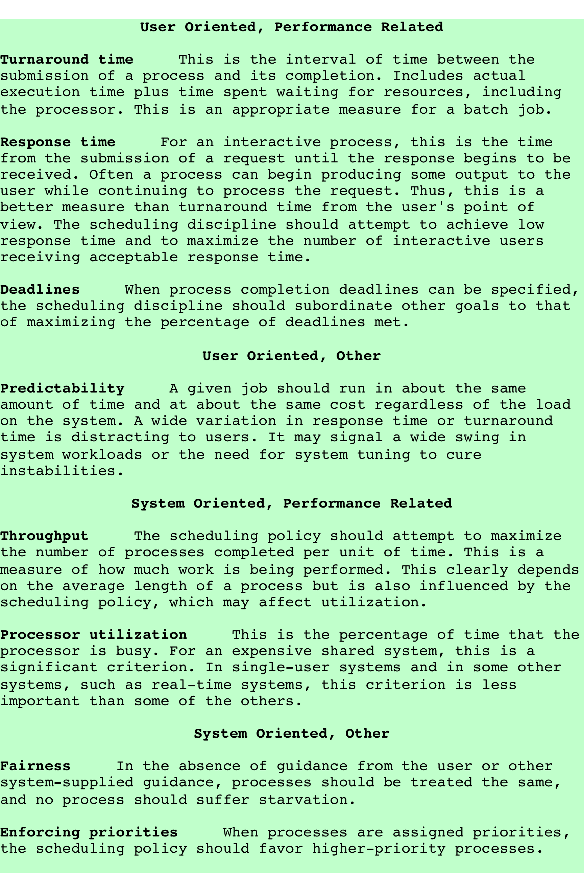
Table 9.2 Scheduling Criteria
Notes:
Table 9.2 summarizes key scheduling criteria. These are interdependent, and
it is impossible to optimize all of them simultaneously. For example, providing good
response time may require a scheduling algorithm that switches between processes
frequently. This increases the overhead of the system, reducing throughput. Thus,
the design of a scheduling policy involves compromising among competing requirements;
the relative weights given the various requirements will depend on the
nature and intended use of the system.
In most interactive operating systems, whether single user or time shared, adequate
response time is the critical requirement. Because of the importance of this
requirement, and because the definition of adequacy will vary from one application
to another, the topic is explored further in Appendix G .

Slide 14
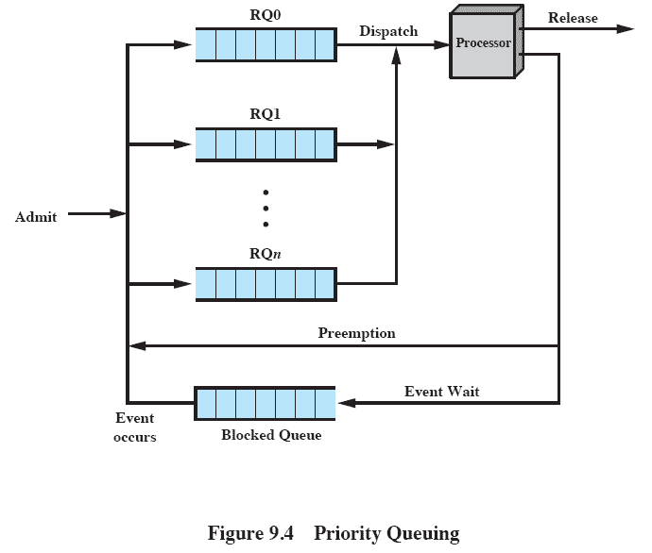
Priority Queuing
Notes:
In many systems, each process is assigned a priority and the scheduler will always
choose a process of higher priority over one of lower priority. Figure 9.4 illustrates the
use of priorities. For clarity, the queuing diagram is simplified, ignoring the existence
of multiple blocked queues and of suspended states (compare Figure 3.8a ). Instead
of a single ready queue, we provide a set of queues, in descending order of priority:
RQ0, RQ1, . . . , RQ n , with priority[RQ i ] > priority[RQ j ] for i > j . 3 When a scheduling
selection is to be made, the scheduler will start at the highest-priority ready queue
(RQ0). If there are one or more processes in the queue, a process is selected using
some scheduling policy. If RQ0 is empty, then RQ1 is examined, and so on.
One problem with a pure priority scheduling scheme is that lower-priority
processes may suffer starvation. This will happen if there is always a steady supply
of higher-priority ready processes. If this behavior is not desirable, the priority of a
process can change with its age or execution history. We will give one example of
this subsequently.

Slide 15
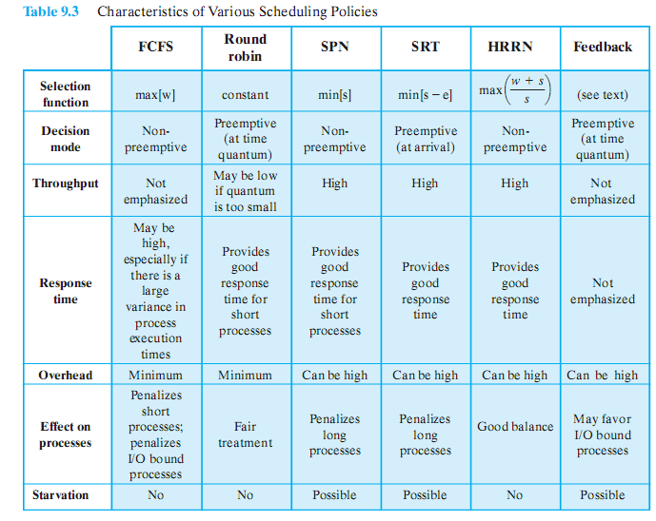
Alternative Scheduling Policies
Notes:
Table 9.3 presents some summary information about the various scheduling policies
that are examined in this subsection

Slide 16
Selection Function
Determines which process, among ready processes, is selected next for execution
May be based on priority, resource requirements, or the execution characteristics of the process
If based on execution characteristics then important quantities are:
w = time spent in system so far, waiting
e = time spent in execution so far
s = total service time required by the process, including e; generally, this quantity must be estimated or supplied by the user
Notes:
. The selection function determines which
process, among ready processes, is selected next for execution. The function may
be based on priority, resource requirements, or the execution characteristics of the
process. In the latter case, three quantities are significant:
w = time spent in system so far, waiting
e = time spent in execution so far
s = total service time required by the process, including e ; generally, this quantity
must be estimated or supplied by the user
For example, the selection function max[ w ] indicates an FCFS discipline.

Slide 17
Decision Mode
Two categories:
Nonpreemptive
Preemptive
Specifies the instants in time at which the selection function is exercised
Notes:
The decision mode specifies the instants in time at which the selection function
is exercised. There are two general categories: nonpreemptive and preemptive

Slide 18
Nonpreemptive vs Preemptive
Nonpreemptive
Preemptive
once a process is in the running state, it will continue until it terminates or blocks itself for I/O
currently running process may be interrupted and moved to ready state by the OS
preemption may occur when new process arrives, on an interrupt, or periodically
Notes:
Non-preemptive
In this case, once a process is in the Running state, it continues to execute until
it terminates or
it blocks itself to wait for I/O or to request some operating system service.
Preemptive:
The currently running process may be interrupted and moved to the Ready state by the operating system.
The decision to preempt may be performed
when a new process arrives;
when an interrupt occurs that places a blocked process in the Ready state;
or periodically, based on a clock interrupt.

Slide 19
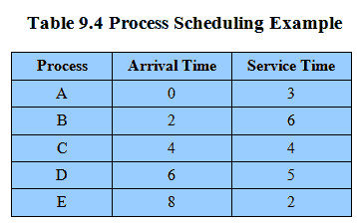

Table 9.4 Process Scheduling Example
Notes:
As we describe the various scheduling policies, we will use the set of processes
in Table 9.4 as a running example. We can think of these as batch jobs, with the
service time being the total execution time required. Alternatively, we can consider
these to be ongoing processes that require alternate use of the processor and I/O
in a repetitive fashion. In this latter case, the service times represent the processor
time required in one cycle. In either case, in terms of a queuing model, this quantity
corresponds to the service time.

Slide 20
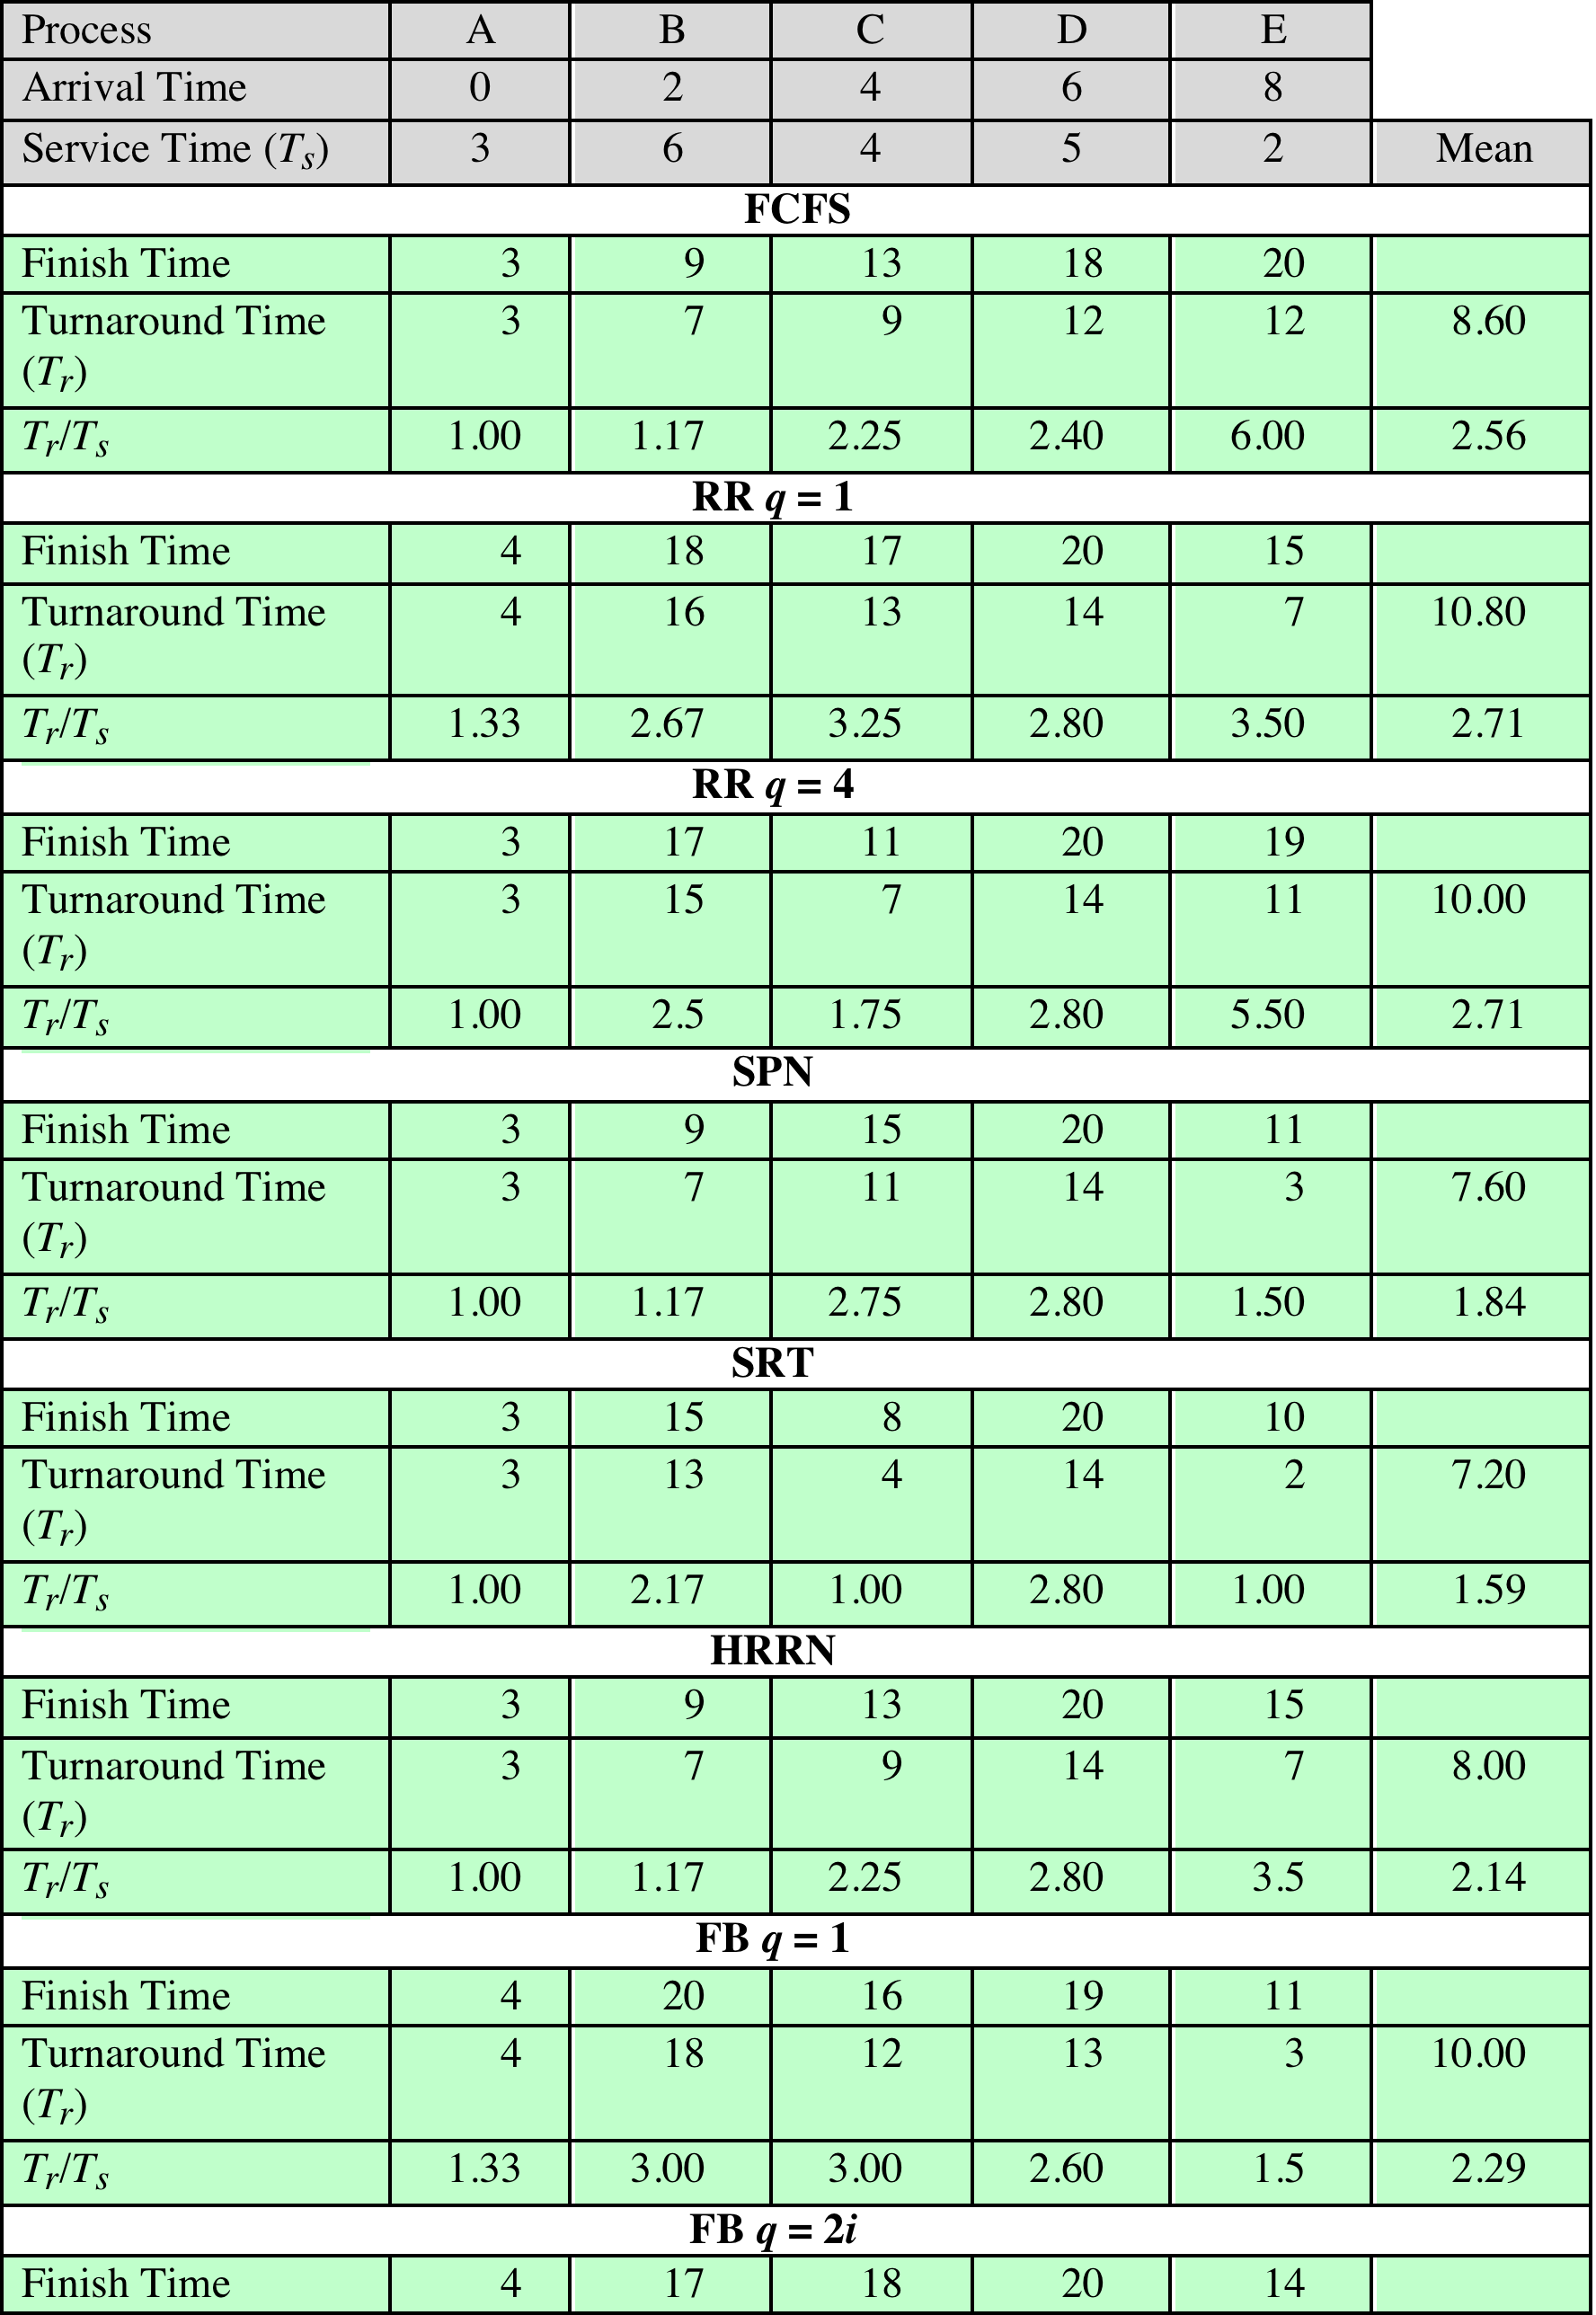
Table 9.5
Comparison of
Scheduling
Policies
T_r / T_s = (T_w + T_s)/T_s
Notes:
For the example of Table 9.4 , Figure 9.5 shows the execution pattern for
each policy for one cycle, and Table 9.5 summarizes some key results. First, the
finish time of each process is determined. From this, we can determine the turnaround
time. In terms of the queuing model, turnaround time (TAT) is the residence
time T r , or total time that the item spends in the system (waiting time plus
service time). A more useful figure is the normalized turnaround time, which
is the ratio of turnaround time to service time. This value indicates the relative
delay experienced by a process. Typically, the longer the process execution time,
the greater is the absolute amount of delay that can be tolerated. The minimum
possible value for this ratio is 1.0; increasing values correspond to a decreasing
level of service.

Slide 21
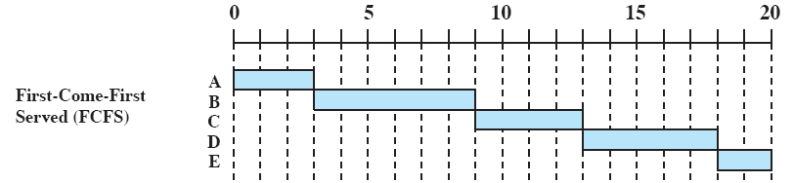
First-Come-First-Served (FCFS)
Simplest scheduling policy
Also known as first-in-first-out (FIFO) or a strict queuing scheme
When the current process ceases to execute, the longest process in the Ready queue is selected
Performs much better for long processes than short ones
Tends to favor processor-bound processes over I/O-bound processes
Notes:
The simplest scheduling policy is first-come-first-served
(FCFS), also known as first-in-first-out (FIFO) or a strict queuing scheme.
As each process becomes ready, it joins the ready queue. When the currently
running process ceases to execute, the process that has been in the ready queue the
longest is selected for running.
FCFS performs much better for long processes than short ones.
Another difficulty with FCFS is that it tends to favor processor-bound processes
over I/O-bound processes. Consider that there is a collection of processes, one of
which mostly uses the processor (processor bound) and a number of which favor I/O
(I/O bound). When a processor-bound process is running, all of the I/O bound processes
must wait. Some of these may be in I/O queues (blocked state) but may move
back to the ready queue while the processor-bound process is executing. At this point,
most or all of the I/O devices may be idle, even though there is potentially work for
them to do. When the currently running process leaves the Running state, the ready
I/O-bound processes quickly move through the Running state and become blocked on
I/O events. If the processor-bound process is also blocked, the processor becomes idle.
Thus, FCFS may result in inefficient use of both the processor and the I/O devices.
FCFS is not an attractive alternative on its own for a uniprocessor system.
However, it is often combined with a priority scheme to provide an effective scheduler.
Thus, the scheduler may maintain a number of queues, one for each priority
level, and dispatch within each queue on a first-come-first-served basis. We see one
example of such a system later, in our discussion of feedback scheduling.

Slide 22
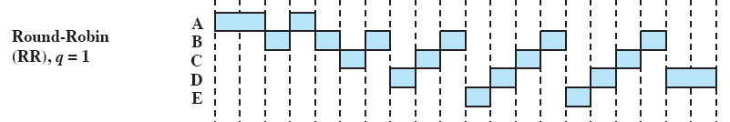
Round Robin
Uses preemption based on a clock
Also known as time slicing because each process is given a slice of time before being preempted
Principal design issue is the length of the time quantum, or slice, to be used
Particularly effective in a general-purpose time-sharing system or transaction processing system
One drawback is its relative treatment of processor-bound and I/O-bound processes
A. B. C. D. E
0 1. 2. 3. 4. 5. 6 7. 8
Notes:
A straightforward way to reduce the penalty that short jobs suffer
with FCFS is to use preemption based on a clock. The simplest such policy is round
robin. A clock interrupt is generated at periodic intervals. When the interrupt
occurs, the currently running process is placed in the ready queue, and the next
ready job is selected on a FCFS basis. This technique is also known as time slicing ,
because each process is given a slice of time before being preempted.
With round robin, the principal design issue is the length of the time quantum,
or slice, to be used. If the quantum is very short, then short processes will move
through the system relatively quickly. On the other hand, there is processing overhead
involved in handling the clock interrupt and performing the scheduling and
dispatching function. Thus, very short time quanta should be avoided.
Round robin is particularly effective in a general-purpose time-sharing system
or transaction processing system. One drawback to round robin is its relative
treatment of processor-bound and I/O-bound processes. Generally, an I/O-bound
process has a shorter processor burst (amount of time spent executing between I/O
operations) than a processor-bound process. If there is a mix of processor-bound
and I/O-bound processes, then the following will happen: An I/O-bound process
uses a processor for a short period and then is blocked for I/O; it waits for the
I/O operation to complete and then joins the ready queue. On the other hand, a
processor-bound process generally uses a complete time quantum while executing
and immediately returns to the ready queue. Thus, processor-bound processes
tend to receive an unfair portion of processor time, which results in poor performance
for I/O-bound processes, inefficient use of I/O devices, and an increase in the
variance of response time.

Slide 23
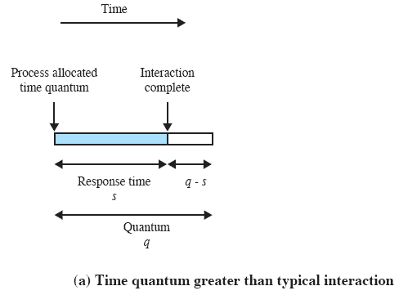
Effect of Size of Preemption Time Quantum
Figure 9.6a
Notes:
One useful guide is that the time quantum should be slightly greater than the time required for
a typical interaction or process function. If it is less, then most processes will require
at least two time quanta. Figure 9.6 illustrates the effect this has on response time.
Note that in the limiting case of a time quantum that is longer than the longest running
process, round robin degenerates to FCFS.

Slide 24
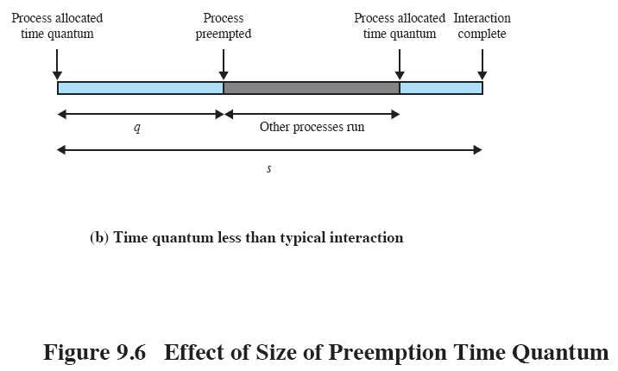
Figure 9.6b Effect of Size of Preemption Time Quantum
Notes:
Figure 9.6 continued.
Effect of size of preemption time quantum.

Slide 25
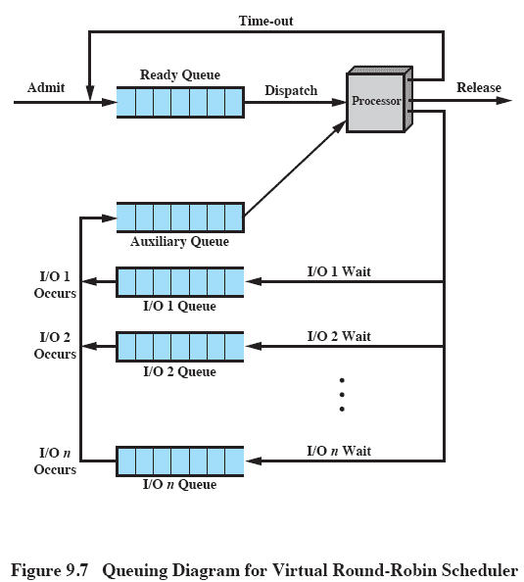
Virtual Round Robin (VRR)
Notes:
[HALD91] suggests a refinement to round robin that he refers to as a virtual
round robin (VRR) and that avoids this unfairness. Figure 9.7 illustrates the scheme.
New processes arrive and join the ready queue, which is managed on an FCFS basis.
When a running process times out, it is returned to the ready queue. When a process
is blocked for I/O, it joins an I/O queue. So far, this is as usual. The new feature is
an FCFS auxiliary queue to which processes are moved after being released from
an I/O block. When a dispatching decision is to be made, processes in the auxiliary
queue get preference over those in the main ready queue. When a process is
dispatched from the auxiliary queue, it runs no longer than a time equal to the basic
time quantum minus the total time spent running since it was last selected from the
main ready queue. Performance studies by the authors indicate that this approach is
indeed superior to round robin in terms of fairness.

Slide 26
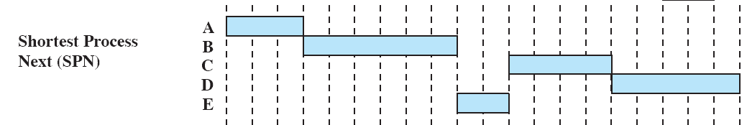
Shortest Process Next (SPN)
Nonpreemptive policy in which the process with the shortest expected processing time is selected next
A short process will jump to the head of the queue
Possibility of starvation for longer processes
One difficulty is the need to know, or at least estimate, the required processing time of each process
If the programmer’s estimate is substantially under the actual running time, the system may abort the job
Notes:
Another approach to reducing the bias in favor of
long processes inherent in FCFS is the shortest process next (SPN) policy. This is
a nonpreemptive policy in which the process with the shortest expected processing
time is selected next. Thus, a short process will jump to the head of the queue past
longer jobs.
Figure 9.5 and Table 9.5 show the results for our example. Note that process
E receives service much earlier than under FCFS. Overall performance is also significantly
improved in terms of response time. However, the variability of response
times is increased, especially for longer processes, and thus predictability is reduced.
One difficulty with the SPN policy is the need to know or at least estimate the
required processing time of each process. For batch jobs, the system may require the
programmer to estimate the value and supply it to the operating system. If the programmer’s
estimate is substantially under the actual running time, the system may abort the
job. In a production environment, the same jobs run frequently, and statistics may be
gathered. For interactive processes, the operating system may keep a running average
of each “burst” for each process.
A risk with SPN is the possibility of starvation for longer processes, as long
as there is a steady supply of shorter processes. On the other hand, although SPN
reduces the bias in favor of longer jobs, it still is not desirable for a time-sharing or
transaction processing environment because of the lack of preemption. Looking
back at our worst-case analysis described under FCFS, processes W, X, Y, and Z
will still execute in the same order, heavily penalizing the short process Y.

Slide 27
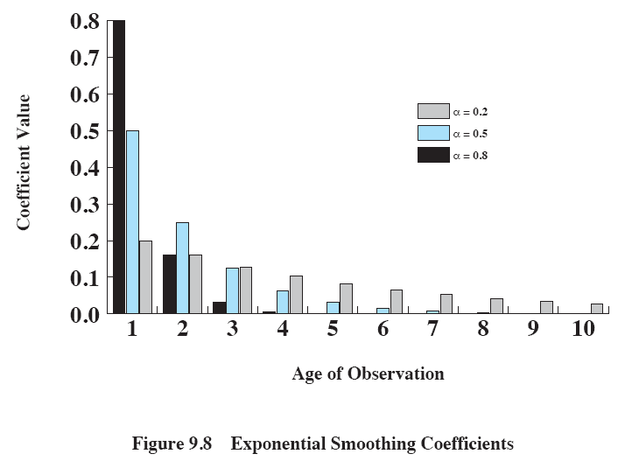
Exponential Smoothing Coefficients
Notes:
The size of the coefficient as a function of its position in the expansion is shown
in Figure 9.8 . The larger the value of , the greater is the weight given to the more
recent observations. For = 0.8, virtually all of the weight is given to the four most
recent observations, whereas for = 0.2, the averaging is effectively spread out over
the eight or so most recent observations. The advantage of using a value of close
to 1 is that the average will quickly reflect a rapid change in the observed quantity.
The disadvantage is that if there is a brief surge in the value of the observed quantity
and it then settles back to some average value, the use of a large value of will
result in jerky changes in the average.

Slide 28
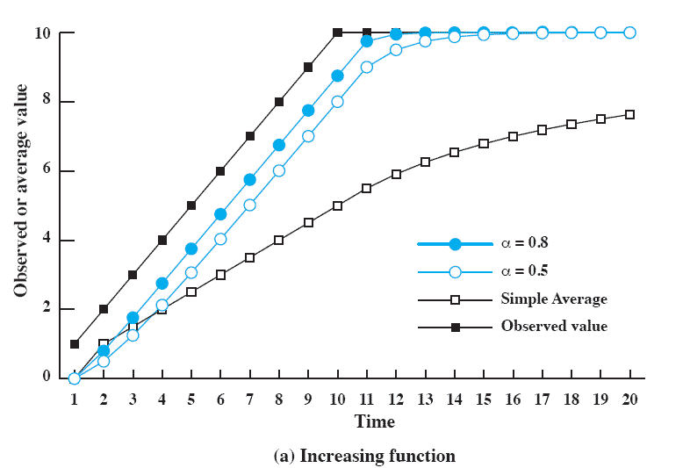
Use Of Exponential Averaging
Notes:
Figure 9.9 compares simple averaging with exponential averaging (for two different values of α).
Here (Figure 9.9a), the observed value begins at 1, grows gradually to a value of 10, and then stays there.

Slide 29
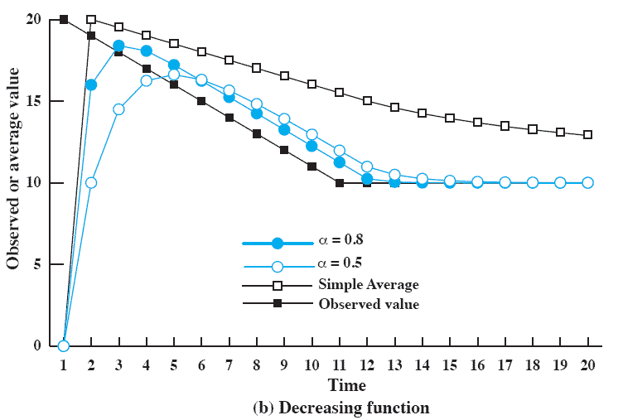
Use Of Exponential Averaging
Notes:
While here (Figure 9.9b), the observed value begins at 20, declines gradually to 10, and then stays there.
In both cases, we start out with an estimate of S₁ = 0.
This gives greater priority to new processes.
Note that exponential averaging tracks changes in process behavior faster than does simple averaging and that the larger value of α results in a more rapid reaction to the change in the observed value.

Slide 30
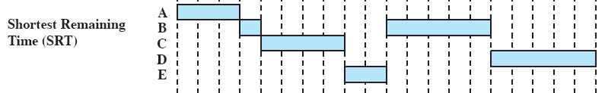
Shortest Remaining Time (SRT)
Preemptive version of SPN
Scheduler always chooses the process that has the shortest expected remaining processing time
Risk of starvation of longer processes
Should give superior turnaround time performance to SPN because a short job is given immediate preference to a running longer job
Notes:
The shortest remaining time (SRT) policy is a
preemptive version of SPN. In this case, the scheduler always chooses the process
that has the shortest expected remaining processing time. When a new process joins
the ready queue, it may in fact have a shorter remaining time than the currently
running process. Accordingly, the scheduler may preempt the current process when
a new process becomes ready. As with SPN, the scheduler must have an estimate of
processing time to perform the selection function, and there is a risk of starvation of
longer processes.
SRT does not have the bias in favor of long processes found in FCFS. Unlike
round robin, no additional interrupts are generated, reducing overhead. On the
other hand, elapsed service times must be recorded, contributing to overhead. SRT
should also give superior turnaround time performance to SPN, because a short job
is given immediate preference to a running longer job.
Note that in our example ( Table 9.5 ), the three shortest processes all receive
immediate service, yielding a normalized turnaround time for each of 1.0.

Slide 31

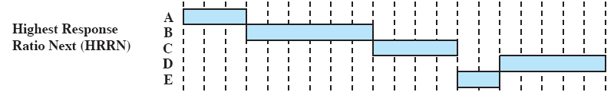
Highest Response Ratio Next (HRRN)
Chooses next process with the greatest ratio
Attractive because it accounts for the age of the process
While shorter jobs are favored, aging without service increases the ratio so that a longer process will eventually get past competing shorter jobs
Notes:
In Table 9.5 , we have used the normalized
turnaround time, which is the ratio of turnaround time to actual service time, as a
figure of merit. For each individual process, we would like to minimize this ratio,
and we would like to minimize the average value over all processes. In general,
we cannot know ahead of time what the service time is going to be, but we can
approximate it, either based on past history or some input from the user or a
configuration manager.
Thus, our scheduling rule becomes the following: when the current process
completes or is blocked, choose the ready process with the greatest value of R .
This approach is attractive because it accounts for the age of the process. While
shorter jobs are favored (a smaller denominator yields a larger ratio), aging without
service increases the ratio so that a longer process will eventually get past competing
shorter jobs.
As with SRT and SPN, the expected service time must be estimated to use
highest response ratio next (HRRN).

Slide 32
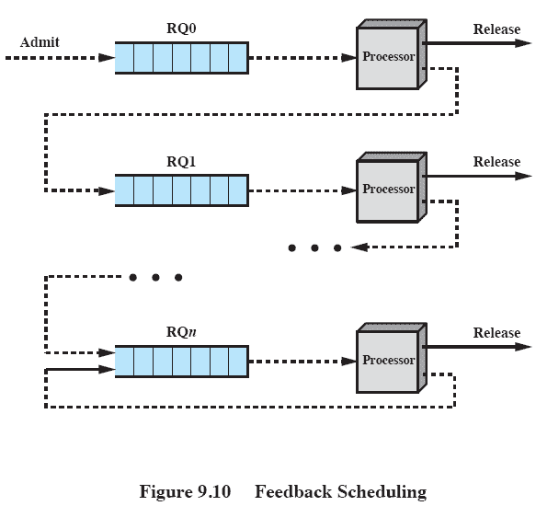
Feedback Scheduling
Notes:
Figure 9.10 illustrates the feedback scheduling mechanism by showing the
path that a process will follow through the various queues. 5 This approach is known
as multilevel feedback , meaning that the operating system allocates the processor
to a process and, when the process blocks or is preempted, feeds it back into one of
several priority queues.

Slide 33
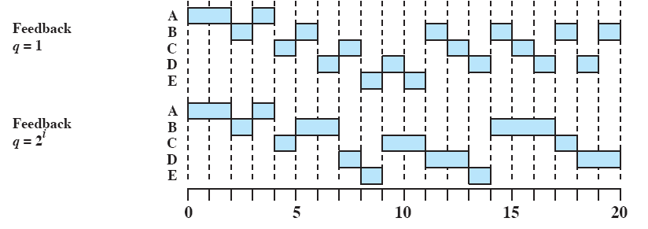
Feedback Performance
Notes:
There are a number of variations on this scheme. A simple version is to perform
preemption in the same fashion as for round robin: at periodic intervals. Our example
shows this ( Figure 9.5 and Table 9.5 ) for a quantum of one time unit. Note that in
this case, the behavior is similar to round robin with a time quantum of 1.
One problem with the simple scheme just outlined is that the turnaround time
of longer processes can stretch out alarmingly. Indeed, it is possible for starvation to
occur if new jobs are entering the system frequently. To compensate for this, we can
vary the preemption times according to the queue: A process scheduled from RQ0
is allowed to execute for one time unit and then is preempted; a process scheduled
from RQ1 is allowed to execute two time units, and so on. In general, a process
scheduled from RQ i is allowed to execute 2 i time units before preemption. This
scheme is illustrated for our example in Figure 9.5 and Table 9.5 .
Even with the allowance for greater time allocation at lower priority, a longer
process may still suffer starvation. A possible remedy is to promote a process to a
higher-priority queue after it spends a certain amount of time waiting for service in
its current queue.

Slide 34
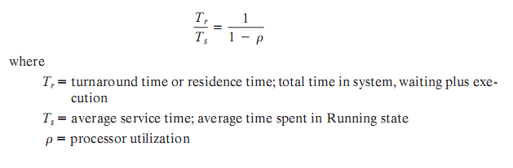
Performance Comparison
Any scheduling discipline that chooses the next item to be served independent of service time obeys the relationship:
Notes:
In this section, we make use of basic queuing formulas, with
the common assumptions of Poisson arrivals and exponential service times. 6
First, we make the observation that any such scheduling discipline that
chooses the next item to be served independent of service time obeys the following
relationship:
(see formula)
In particular, a priority-based scheduler, in which the priority of each process
is assigned independent of expected service time, provides the same average turnaround
time and average normalized turnaround time as a simple FCFS discipline.
Furthermore, the presence or absence of preemption makes no differences in these
averages.
With the exception of round robin and FCFS, the various scheduling disciplines
considered so far do make selections on the basis of expected service time.
Unfortunately, it turns out to be quite difficult to develop closed analytic models
of these disciplines. However, we can get an idea of the relative performance of
such scheduling algorithms, compared to FCFS, by considering priority scheduling
in which priority is based on service time.

Slide 35
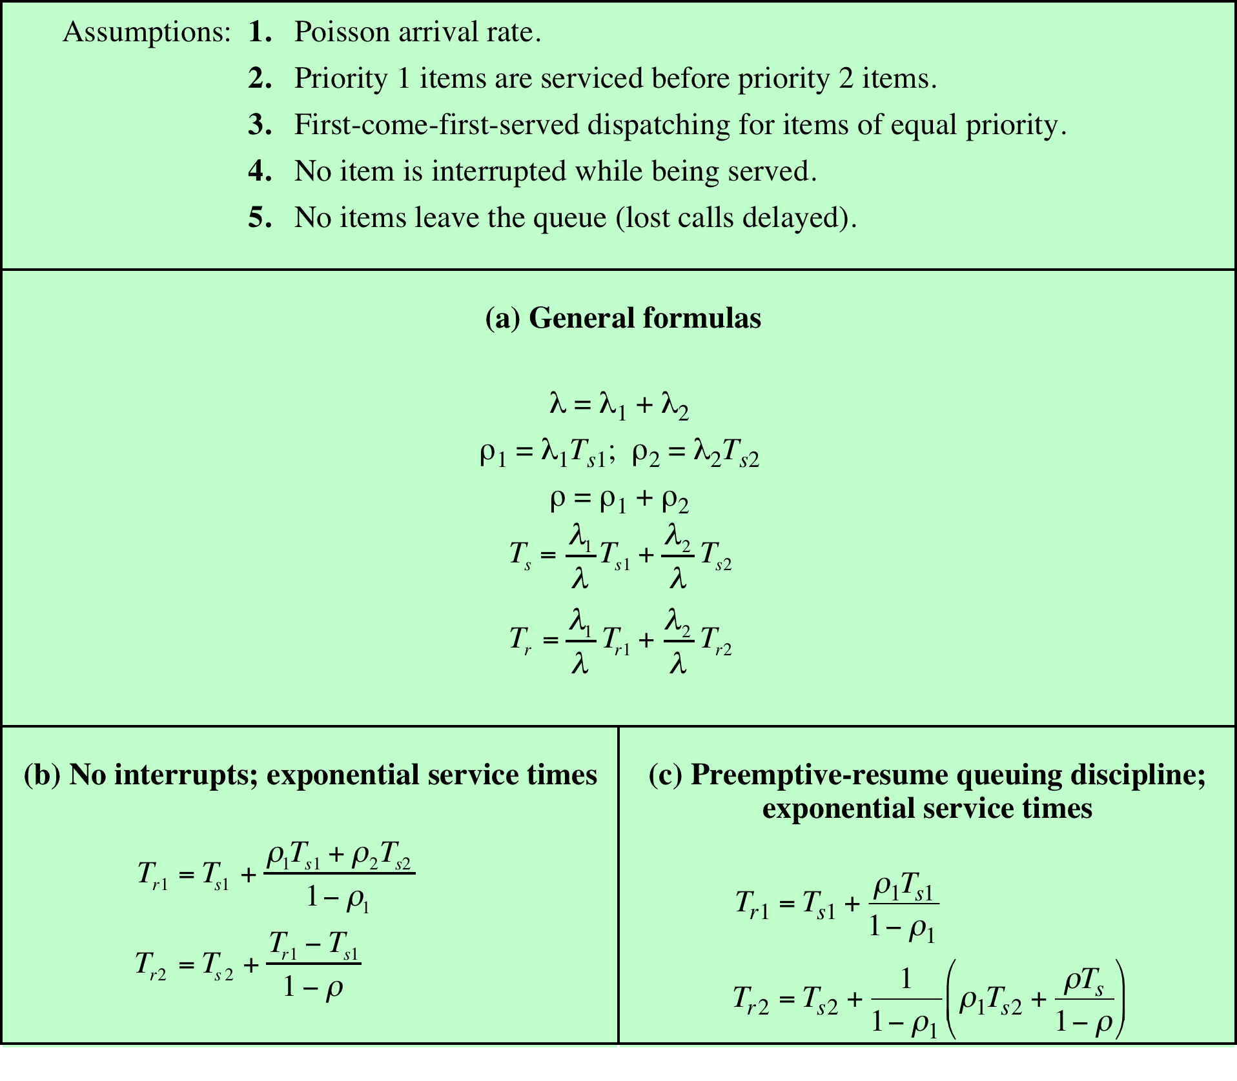
Table 9.6
Formulas for Single-Server Queues with Two Priority Categories
Notes:
If scheduling is done on the basis of priority and if processes are assigned to
a priority class on the basis of service time, then differences do emerge. Table 9.6
shows the formulas that result when we assume two priority classes, with different
service times for each class. In the table, refers to the arrival rate. These results can
be generalized to any number of priority classes. Note that the formulas differ for
nonpreemptive versus preemptive scheduling. In the latter case, it is assumed that
a lower-priority process is immediately interrupted when a higher-priority process
becomes ready.

Slide 36
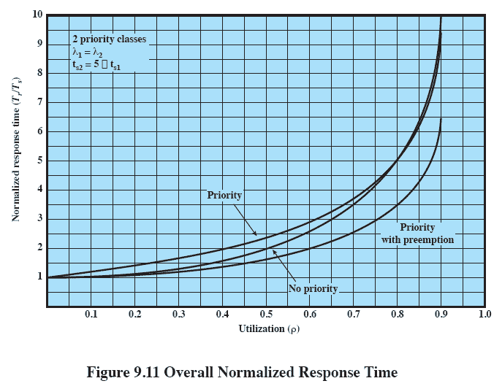
Overall Normalized Response Time
Notes:
As an example, let us consider the case of two priority classes, with an equal
number of process arrivals in each class and with the average service time for the
lower-priority class being five times that of the upper priority class. Thus, we wish to
give preference to shorter processes. Figure 9.11 shows the overall result. By giving
preference to shorter jobs, the average normalized turnaround time is improved
at higher levels of utilization. As might be expected, the improvement is greatest
with the use of preemption. Notice, however, that overall performance is not much
affected.

Slide 37
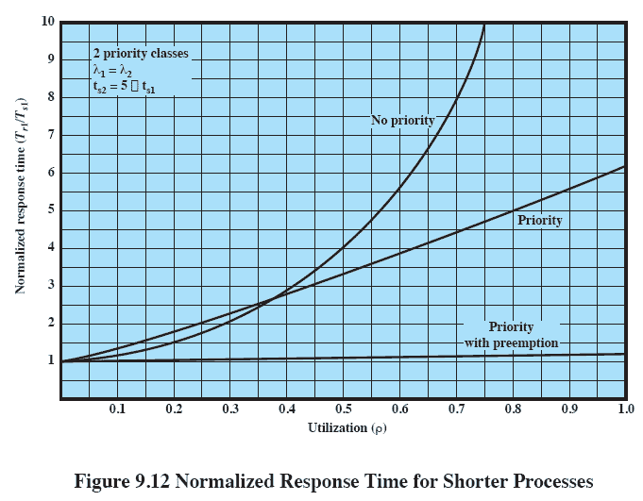
Normalized Response Time for Shorter Processes
Notes:
However, significant differences emerge when we consider the two priority
classes separately. Figure 9.12 shows the results for the higher-priority, shorter
processes. For comparison, the upper line on the graph assumes that priorities are
not used but that we are simply looking at the relative performance of that half of
all processes that have the shorter processing time. The other two lines assume that
these processes are assigned a higher priority. When the system is run using priority
scheduling without preemption, the improvements are significant. They are even
more significant when preemption is used.

Slide 38
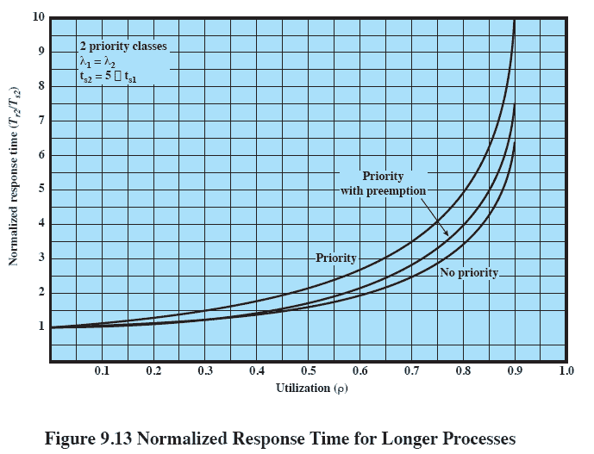
Normalized Response Time for Longer Processes
Notes:
Figure 9.13 shows the same analysis for the lower-priority, longer processes.
As expected, such processes suffer a performance degradation under priority
scheduling.

Slide 39
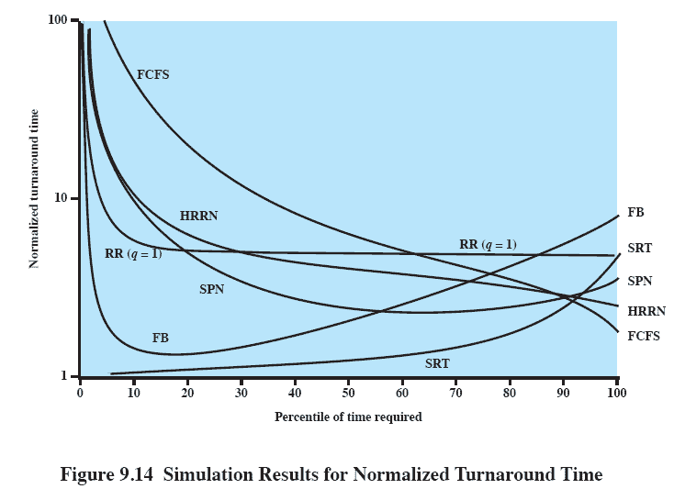
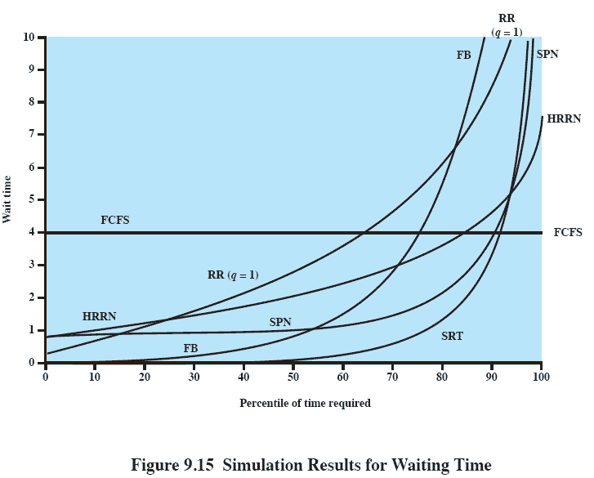
Results
Simulation
Notes:
Some of the difficulties of analytic modeling are
overcome by using discrete-event simulation, which allows a wide range of policies
to be modeled. The disadvantage of simulation is that the results for a given “run”
only apply to that particular collection of processes under that particular set of
assumptions. Nevertheless, useful insights can be gained.
The results of one such study are reported in [FINK88]. The simulation
involved 50,000 processes with an arrival rate of 0.8 and an average service time
of T s 1. Thus, the assumption is that the processor utilization is r = T s = 0.8.
Note, therefore, that we are only measuring one utilization point.
To present the results, processes are grouped into service-time percentiles,
each of which has 500 processes. Thus, the 500 processes with the shortest service
time are in the first percentile; with these eliminated, the 500 remaining processes
with the shortest service time are in the second percentile; and so on. This allows
us to view the effect of various policies on processes as a function of the length of
the process.
Figure 9.14 shows the normalized turnaround time, and Figure 9.15 shows
the average waiting time. Looking at the turnaround time, we can see that the
performance of FCFS is very unfavorable, with one-third of the processes having
a normalized turnaround time greater than 10 times the service time; furthermore,
these are the shortest processes. On the other hand, the absolute waiting time is
uniform, as is to be expected because scheduling is independent of service time.
The figures show round robin using a quantum of one time unit. Except for the
shortest processes, which execute in less than one quantum, round robin yields
a normalized turnaround time of about five for all processes, treating all fairly.
Shortest process next performs better than round robin, except for the shortest
processes. Shortest remaining time, the preemptive version of SPN, performs better
than SPN except for the longest 7% of all processes. We have seen that, among
nonpreemptive policies, FCFS favors long processes and SPN favors short ones.
Highest response ratio next is intended to be a compromise between these two
effects, and this is indeed confirmed in the figures. Finally, the figure shows feedback
scheduling with fixed, uniform quanta in each priority queue. As expected,
FB performs quite well for short processes.

Slide 40
Fair-Share Scheduling
Scheduling decisions based on the process sets
Each user is assigned a share of the processor
Objective is to monitor usage to give fewer resources to users who have had more than their fair share and more to those who have had less than their fair share
Notes:
All of the scheduling algorithms discussed so far treat the collection of ready
processes as a single pool of processes from which to select the next running process.
This pool may be broken down by priority but is otherwise homogeneous.
However, in a multiuser system, if individual user applications or jobs may be
organized as multiple processes (or threads), then there is a structure to the collection
of processes that is not recognized by a traditional scheduler. From the user’s
point of view, the concern is not how a particular process performs but rather how
his or her set of processes, which constitute a single application, performs. Thus, it
would be attractive to make scheduling decisions on the basis of these process sets.
This approach is generally known as fair-share scheduling. Further, the concept can
be extended to groups of users, even if each user is represented by a single process.
For example, in a time-sharing system, we might wish to consider all of the users
from a given department to be members of the same group. Scheduling decisions
could then be made that attempt to give each group similar service. Thus, if a large
number of people from one department log onto the system, we would like to see
response time degradation primarily affect members of that department rather than
users from other departments.
The term fair share indicates the philosophy behind such a scheduler. Each
user is assigned a weighting of some sort that defines that user’s share of system
resources as a fraction of the total usage of those resources. In particular, each
user is assigned a share of the processor. Such a scheme should operate in a more
or less linear fashion, so that if user A has twice the weighting of user B, then in
the long run, user A should be able to do twice as much work as user B. The objective
of a fair-share scheduler is to monitor usage to give fewer resources to users
who have had more than their fair share and more to those who have had less than
their fair share.

Slide 41
Fair-Share Scheduling
Notes:
All of the scheduling algorithms discussed so far treat the collection of ready
processes as a single pool of processes from which to select the next running process.
This pool may be broken down by priority but is otherwise homogeneous.
However, in a multiuser system, if individual user applications or jobs may be
organized as multiple processes (or threads), then there is a structure to the collection
of processes that is not recognized by a traditional scheduler. From the user’s
point of view, the concern is not how a particular process performs but rather how
his or her set of processes, which constitute a single application, performs. Thus, it
would be attractive to make scheduling decisions on the basis of these process sets.
This approach is generally known as fair-share scheduling. Further, the concept can
be extended to groups of users, even if each user is represented by a single process.
For example, in a time-sharing system, we might wish to consider all of the users
from a given department to be members of the same group. Scheduling decisions
could then be made that attempt to give each group similar service. Thus, if a large
number of people from one department log onto the system, we would like to see
response time degradation primarily affect members of that department rather than
users from other departments.
The term fair share indicates the philosophy behind such a scheduler. Each
user is assigned a weighting of some sort that defines that user’s share of system
resources as a fraction of the total usage of those resources. In particular, each
user is assigned a share of the processor. Such a scheme should operate in a more
or less linear fashion, so that if user A has twice the weighting of user B, then in
the long run, user A should be able to do twice as much work as user B. The objective
of a fair-share scheduler is to monitor usage to give fewer resources to users
who have had more than their fair share and more to those who have had less than
their fair share.

Slide 42
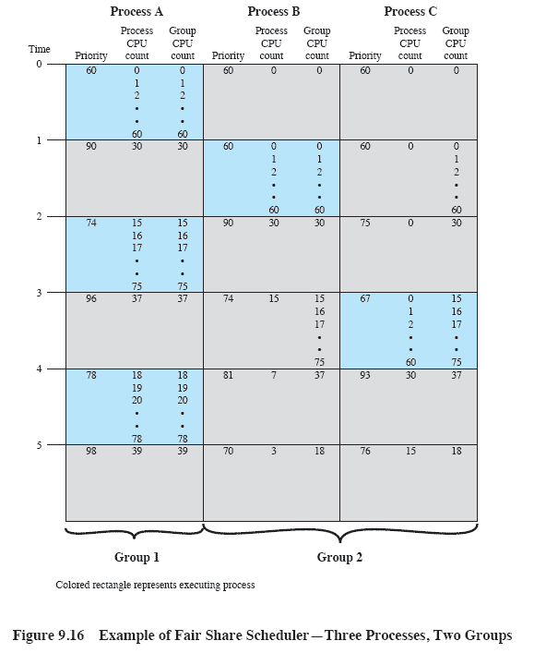
Fair-Share Scheduler
Notes:
Figure 9.16 is an example in which process A is in one group and processes B
and C are in a second group, with each group having a weighting of 0.5. Assume that
all processes are processor bound and are usually ready to run. All processes have
a base priority of 60. Processor utilization is measured as follows: The processor is
interrupted 60 times per second; during each interrupt, the processor usage field of
the currently running process is incremented, as is the corresponding group processor
field. Once per second, priorities are recalculated.
In the figure, process A is scheduled first. At the end of one second, it is
preempted. Processes B and C now have the higher priority, and process B is scheduled.
At the end of the second time unit, process A has the highest priority. Note
that the pattern repeats: the kernel schedules the processes in order: A, B, A, C, A,
B, and so on. Thus, 50% of the processor is allocated to process A, which constitutes
one group, and 50% to processes B and C, which constitute another group.

Slide 43
Traditional UNIX Scheduling
Used in both SVR3 and 4.3 BSD UNIX
these systems are primarily targeted at the time-sharing interactive environment
Designed to provide good response time for interactive users while ensuring that low-priority background jobs do not starve
Employs multilevel feedback using round robin within each of the priority queues
Makes use of one-second preemption
Priority is based on process type and execution history
Notes:
In this section we examine traditional UNIX scheduling, which is used in both
SVR3 and 4.3 BSD UNIX. These systems are primarily targeted at the time-sharing
interactive environment. The scheduling algorithm is designed to provide good
response time for interactive users while ensuring that low-priority background
jobs do not starve. Although this algorithm has been replaced in modern UNIX
systems, it is worthwhile to examine the approach because it is representative of
practical time-sharing scheduling algorithms. The scheduling scheme for SVR4
includes an accommodation for real-time requirements, and so its discussion is
deferred to Chapter 10 .
The traditional UNIX scheduler employs multilevel feedback using round
robin within each of the priority queues. The system makes use of one-second
preemption. That is, if a running process does not block or complete within one
second, it is preempted. Priority is based on process type and execution history.

Slide 44
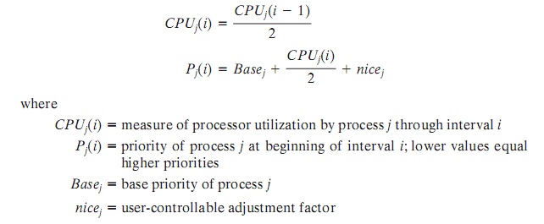
Scheduling Formula
Notes:
The priority of each process is recomputed once per second, at which time a
new scheduling decision is made. The purpose of the base priority is to divide all
processes into fixed bands of priority levels. The CPU and nice components are
restricted to prevent a process from migrating out of its assigned band (assigned by
the base priority level). These bands are used to optimize access to block devices
(e.g., disk) and to allow the operating system to respond quickly to system calls.

Slide 45
Bands
Swapper
Block I/O device control
File manipulation
Character I/O device control
User processes
Used to optimize access to block devices and to allow the operating system to respond quickly to system calls
In decreasing order of priority, the bands are:
Notes:
In decreasing order of priority, the bands are:
• Swapper
• Block I/O device control
• File manipulation
• Character I/O device control
• User processes
This hierarchy should provide the most efficient use of the I/O devices.
Within the user process band, the use of execution history tends to penalize processor-
bound processes at the expense of I/O-bound processes. Again, this should
improve efficiency. Coupled with the round-robin preemption scheme, the scheduling
strategy is well equipped to satisfy the requirements for general-purpose
time sharing.

Slide 46
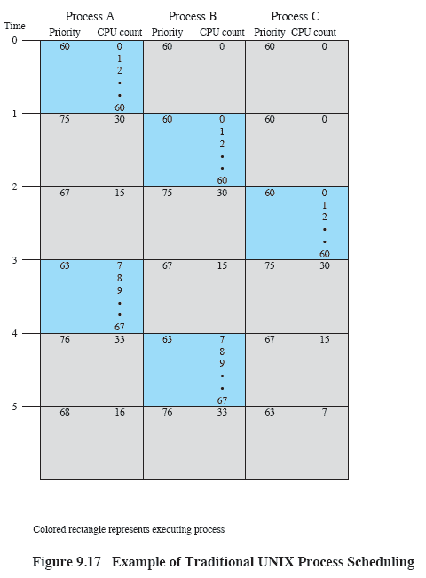
Example of Traditional UNIX Process Scheduling
Notes:
An example of process scheduling is shown in Figure 9.17 . Processes A, B,
and C are created at the same time with base priorities of 60 (we will ignore the
nice value). The clock interrupts the system 60 times per second and increments
a counter for the running process. The example assumes that none of the processes
block themselves and that no other processes are ready to run. Compare
this with Figure 9.16 .

Slide 47

Summary
The operating system must make three types of scheduling decisions with respect to the execution of processes:
Long-term – determines when new processes are admitted to the system
Medium-term – part of the swapping function and determines when a program is brought into main memory so that it may be executed
Short-term – determines which ready process will be executed next by the processor
From a user’s point of view, response time is generally the most important characteristic of a system; from a system point of view, throughput or processor utilization is important
Algorithms:
FCFS, Round Robin, SPN, SRT, HRRN, Feedback
Notes:
The operating system must make three types of scheduling decisions with respect to
the execution of processes. Long-term scheduling determines when new processes
are admitted to the system. Medium-term scheduling is part of the swapping function
and determines when a program is brought partially or fully into main memory
so that it may be executed. Short-term scheduling determines which ready process
will be executed next by the processor. This chapter focuses on the issues relating to
short-term scheduling.
A variety of criteria are used in designing the short-term scheduler. Some of
these criteria relate to the behavior of the system as perceived by the individual user
(user oriented), while others view the total effectiveness of the system in meeting
the needs of all users (system oriented). Some of the criteria relate specifically to
quantitative measures of performance, while others are more qualitative in nature.
From a user’s point of view, response time is generally the most important characteristic
of a system, while from a system point of view, throughput or processor
utilization is important.
A variety of algorithms have been developed for making the short-term scheduling
decision among all ready processes:
• First-come-first-served : Select the process that has been waiting the longest
for service.
• Round robin : Use time slicing to limit any running process to a short burst of
processor time, and rotate among all ready processes.
• Shortest process next: Select the process with the shortest expected processing
time, and do not preempt the process.
• Shortest remaining time: Select the process with the shortest expected remaining
process time. A process may be preempted when another process becomes
ready.
• Highest response ratio next: Base the scheduling decision on an estimate of
normalized turnaround time.
• Feedback: Establish a set of scheduling queues and allocate processes to
queues based on execution history and other criteria.
The choice of scheduling algorithm will depend on expected performance and
on implementation complexity.

